Slide 1

Uber price prediction
By Kaveri

Slide 2
Introduction
Problem statement- Given the growing popularity of uber, it has become essential to build an app that enhances transparency, improves user experience, and supports better decision-making for both users and the company. This app plays a crucial role in optimizing the pricing strategy.
Objective-The goal of this project is to develop a machine learning model that can accurately predict the price of an Uber ride given specific input features such as the pickup and dropoff locations, time of day, and other relevant factors.

Slide 3
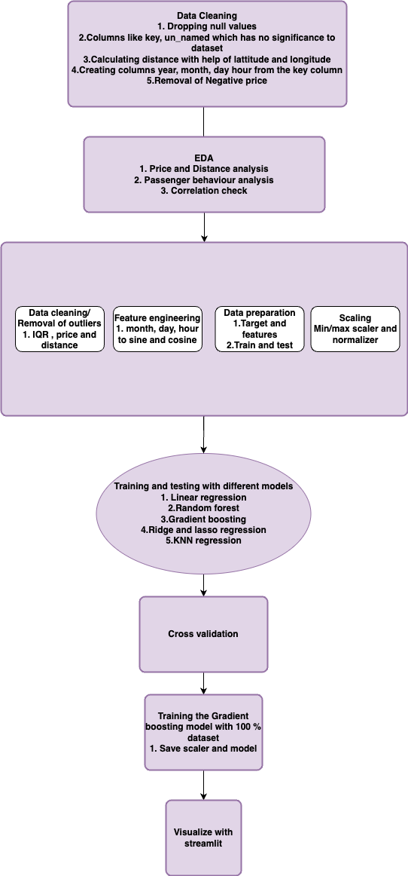
Project overview

Slide 4
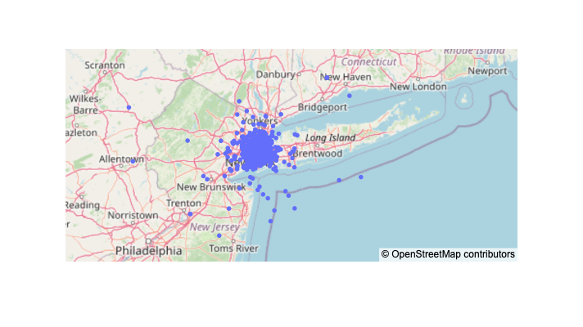
Data overview
The data is collected from kaggle.
200k rows and 8 columns,of New York city from 2009-2015 .
passenger_count | Numerical discrete
fare_amount | Numerical continuous
pickup_datetime | Numerical Date format
pickup_longitude | Numerical
pickup_latitude | Numerical
dropoff_longitude | Numerical
dropoff_latitude | Numerical

Slide 5
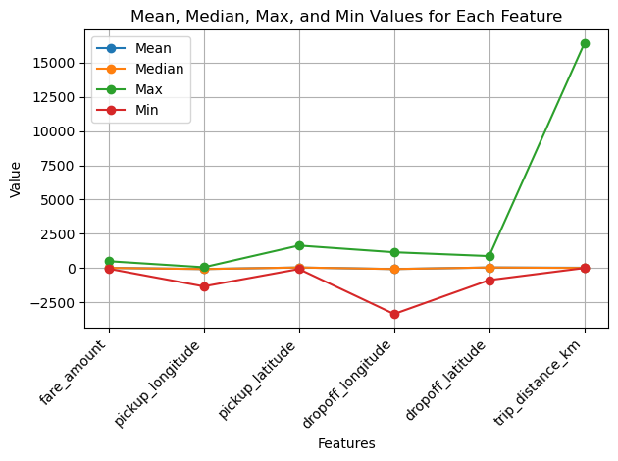
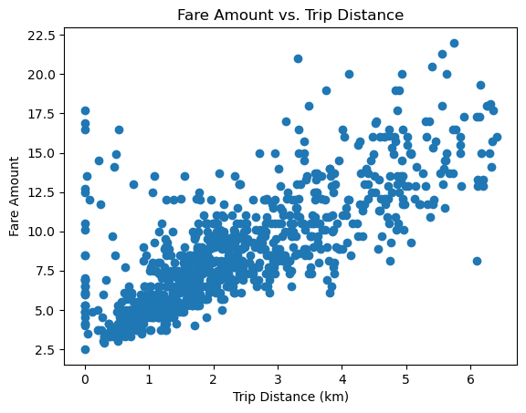
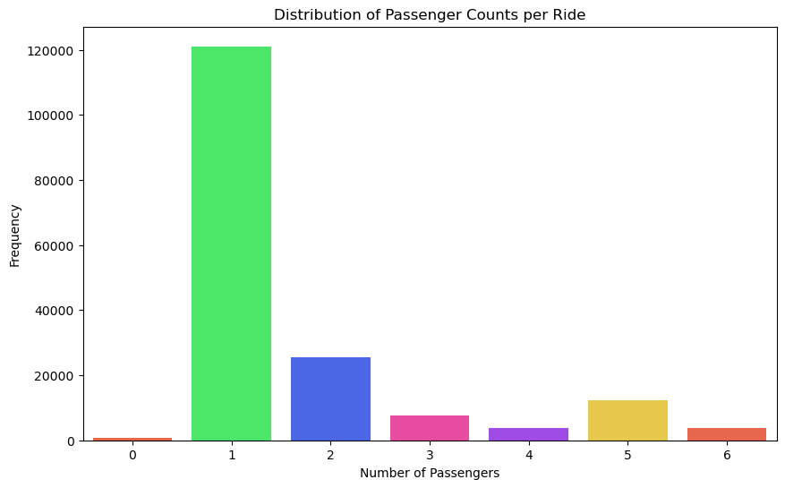
EDA

Slide 6
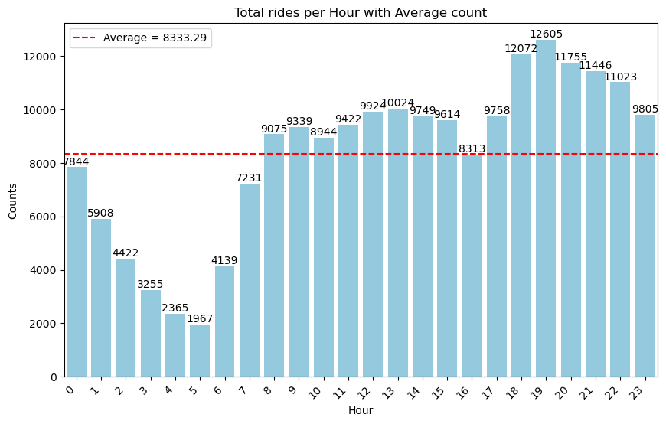
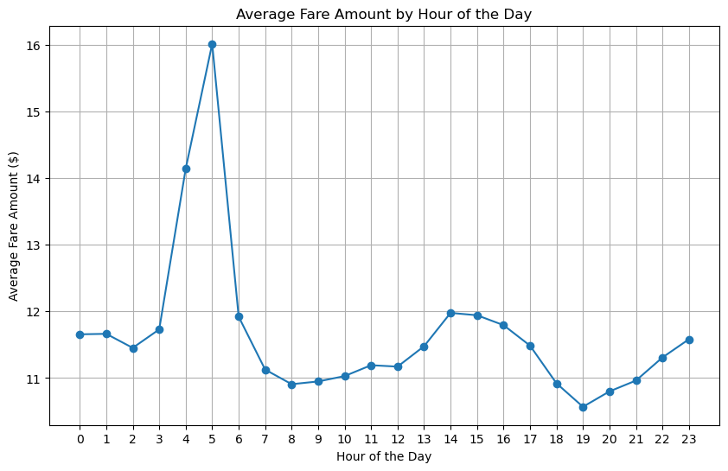
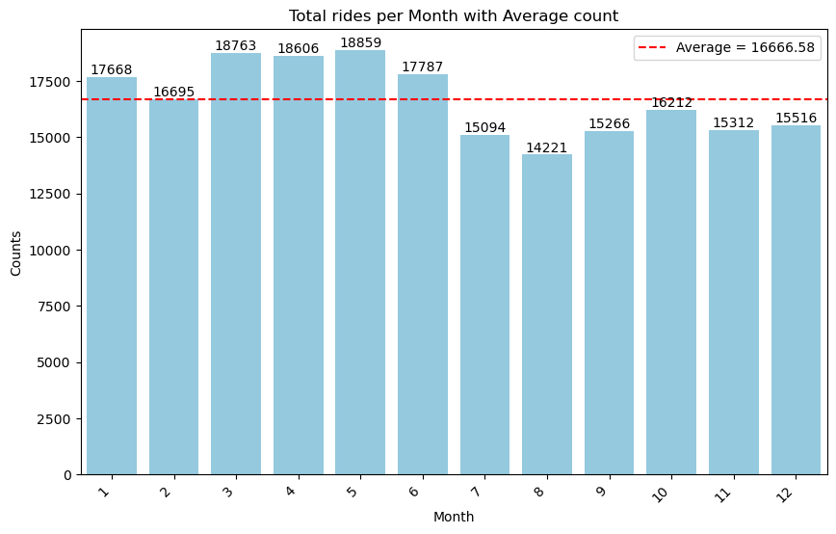
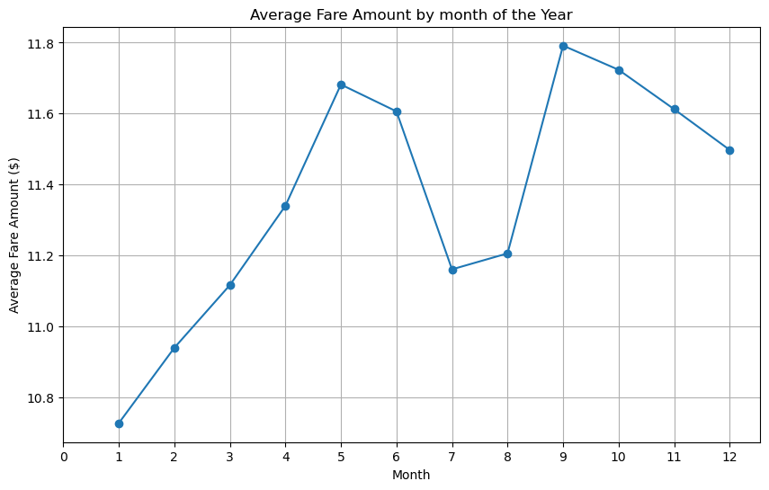
How price changes with demand ?
Peak hour:
Peak price:
Busiest hour(7 PM)
Costliest(5 AM)
Cheapest(7 PM)
Idle hour(5 AM)
Variation of price by month
Total ride count per month:

Slide 7
Data pre-processing
Data cleaning
Feature engineering
Data normalization

Slide 8
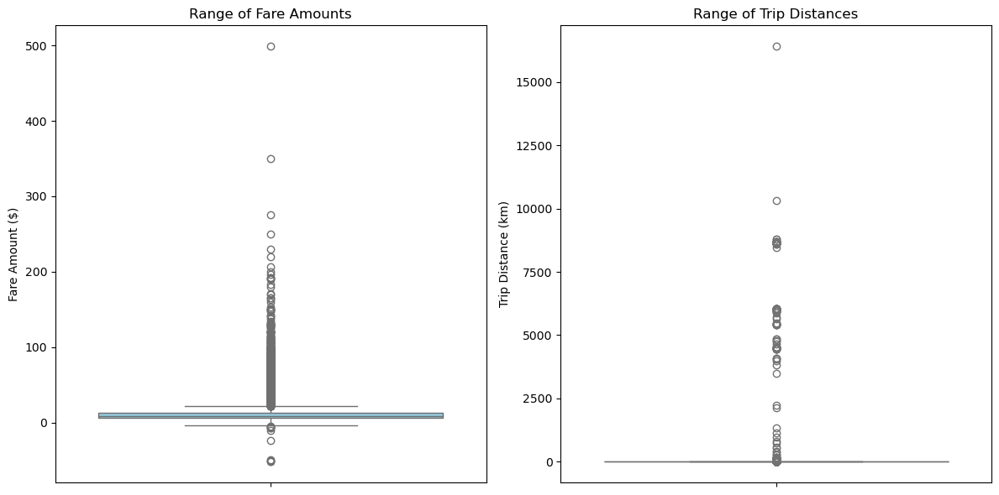
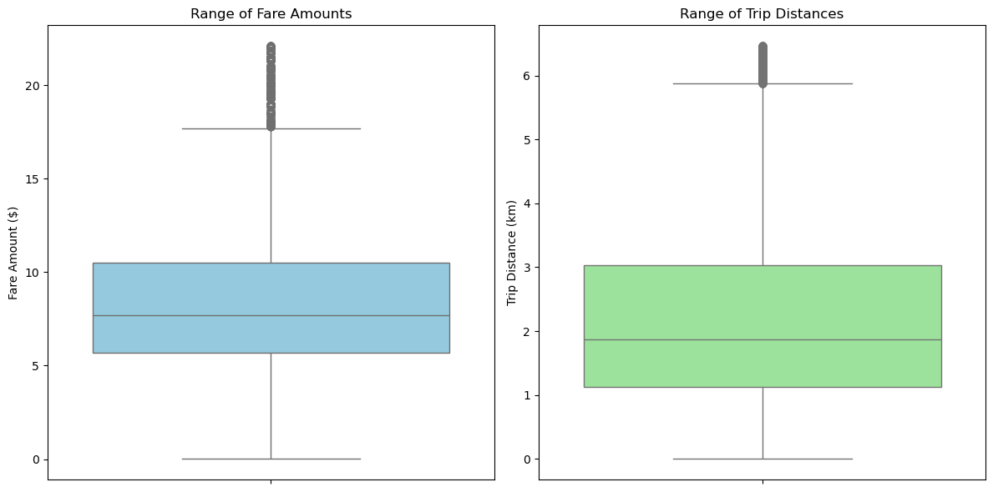
Data cleaning
Calculate distance from pick up and drop off(latitude,longitude)
Splitting pickup_datetime column to date, month, day for better calculation
Dealing outliers from the target and the features.
Before
After

Slide 9
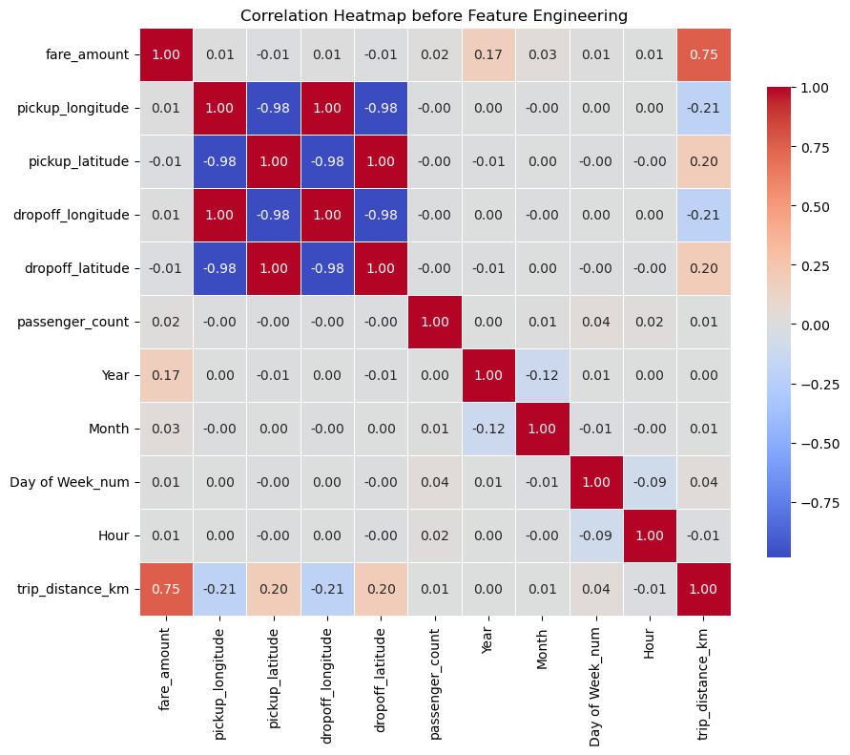
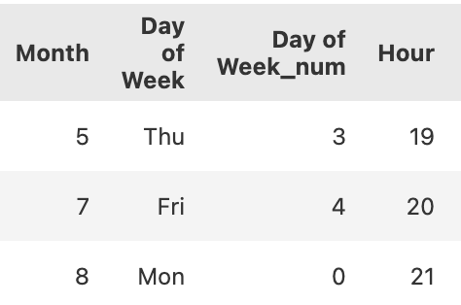
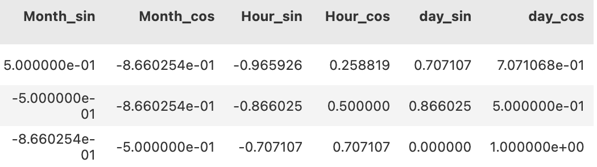
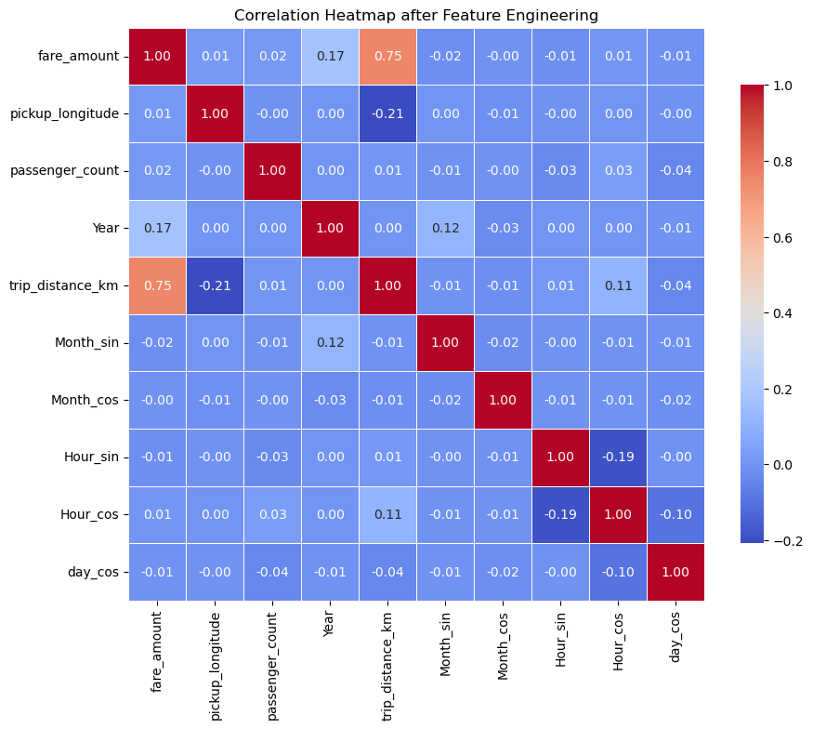
Feature engineering

Slide 10
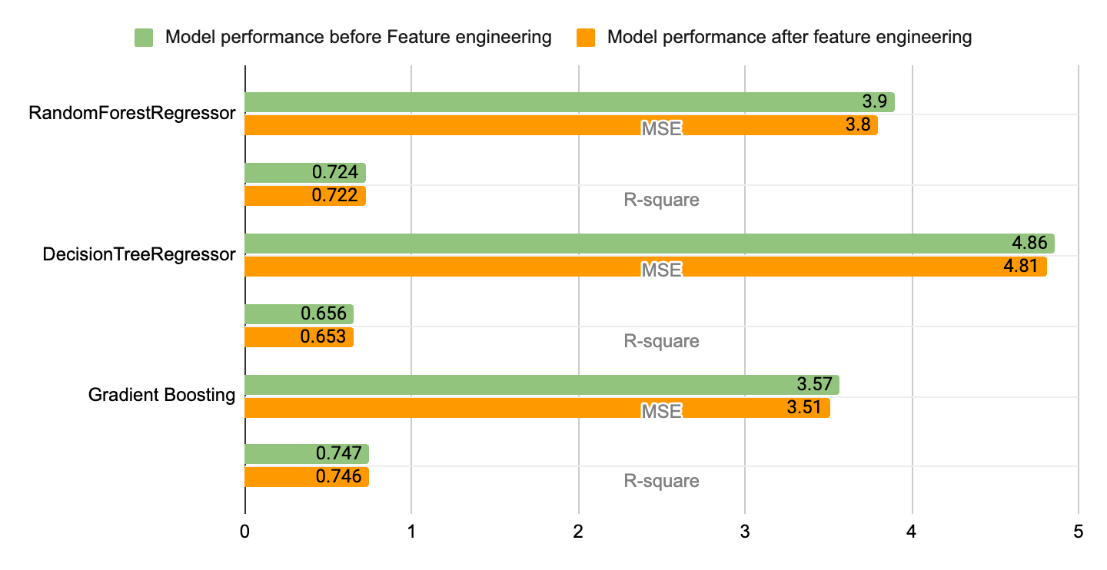
Interestingly, it shows very little improvement to the models after and before feature engineering.

Slide 11
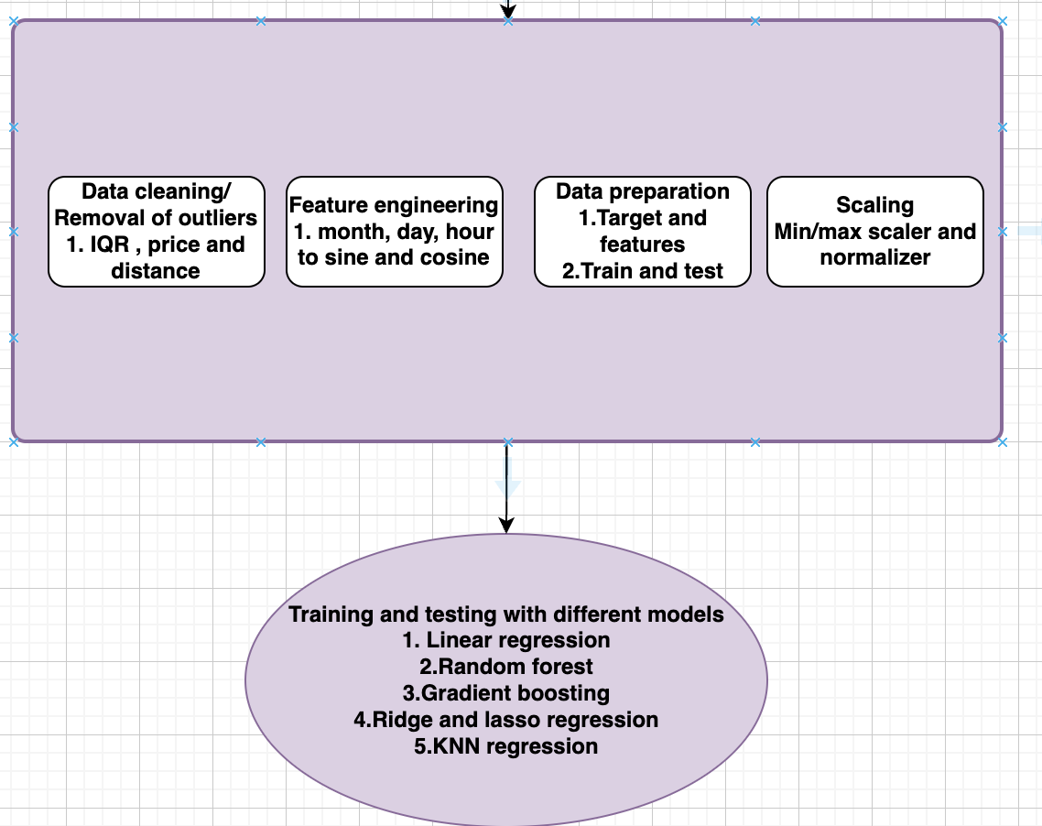
Modeling

Slide 12
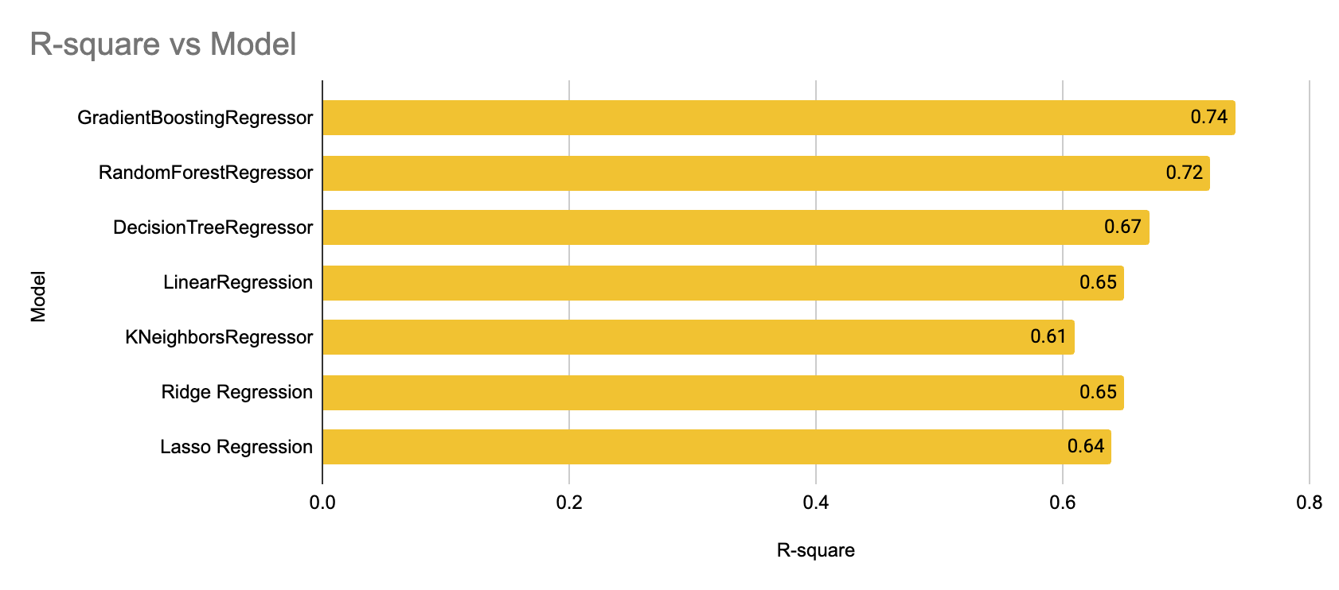
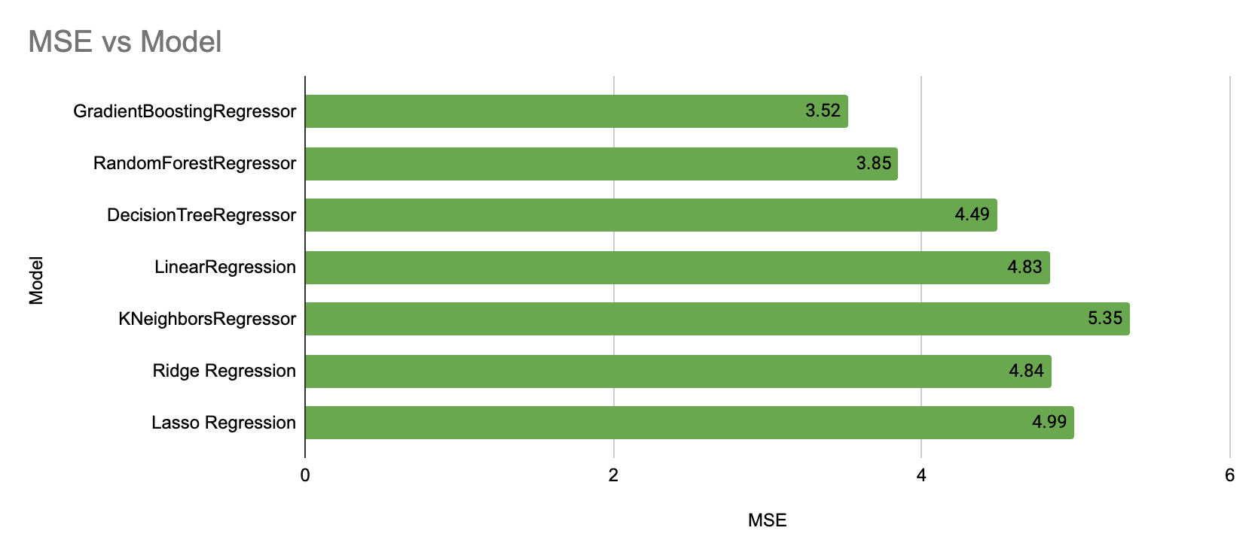
Model evaluation
Considering Gradient boosting and Random forest are the most effective model with highest R-2 and lowest MSE, next step is to model optimization with grid search-Hyperparameter tuning and k-fold for cross validation.

Slide 13
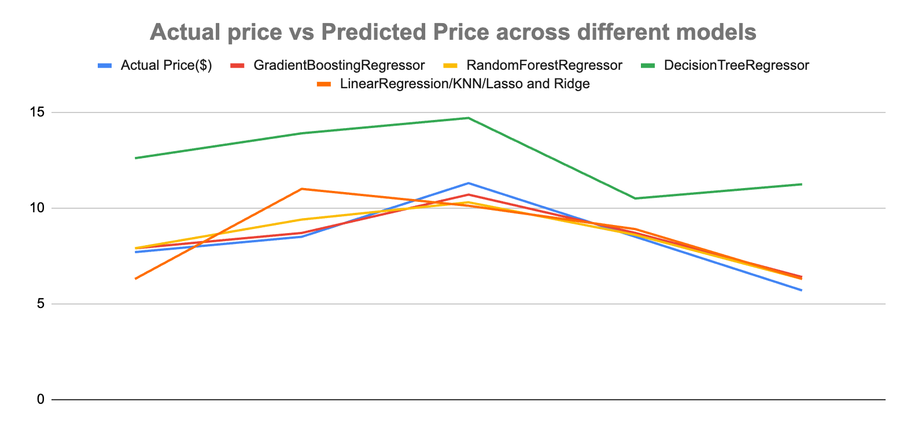
Results
Best
Good
Model optimization with k-fold Cross validation

Slide 14
Streamlit

Slide 15
Challenges and limitation
Limited computing power and time consuming processes (specially grid search for hyperparameter tuning)
Challenging to improve the R-square, even after trying many permutation combinations.

Slide 16
Future scope
Integration with Weather data from an API. But gave error 423
Incorporate live traffic data to predict delays and adjust fare estimates based on expected travel time.

Slide 17
Conclusion
In conclusion, the Uber Fare Prediction project successfully demonstrates the application of machine learning to predict ride costs based on various factors such as distance, time, and location. By developing this model, we enhance transparency for users, allowing them to anticipate fare costs more accurately, which improves their overall experience. Additionally, the model provides valuable insights for Uber, enabling the company to manage demand more efficiently and optimize pricing strategies. This project lays the groundwork for future enhancements, such as integrating real-time data, expanding to other ride-sharing platforms, and developing personalized fare prediction models. Overall, the project not only benefits users by offering cost predictability but also supports Uber in maintaining a competitive edge in the dynamic ride-sharing market.

